Slide 1
Foreign direct investment

Slide 2
Objective: To analyze the performance of different sectors over the years from 2000 to 2005.
Data Source: Power BI Dashboard

Slide 3
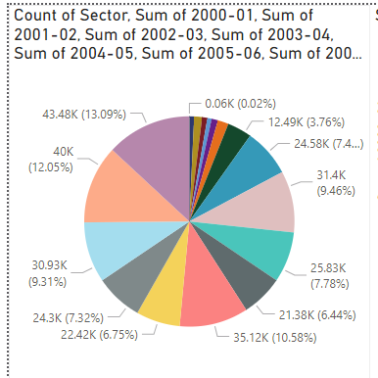
Overview of sectors.
The largest sector is Miscellaneous with 43.48K (13.09%).
Other significant sectors include Computers (35.12K, 10.58%) and Telecommunication (31.4K, 9.46%).

Slide 4
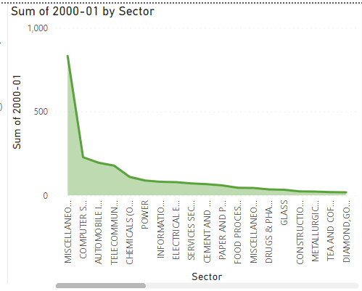
Yearly Sector Analysis - 2000-01
The Miscellaneous sector is the top performer with over 900 units.
A significant drop after the top sector.

Slide 5
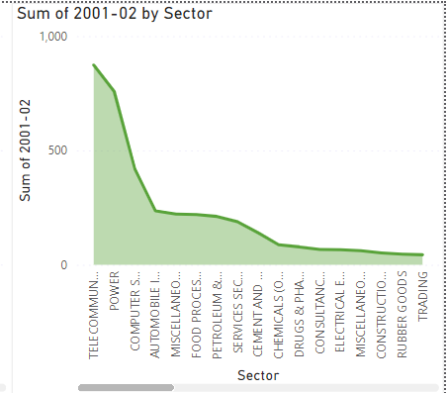
Yearly Sector Analysis - 2001-02
The Telecommunication sector leads, showing a change from the previous year.
Notable performance from Power and Computers.

Slide 6
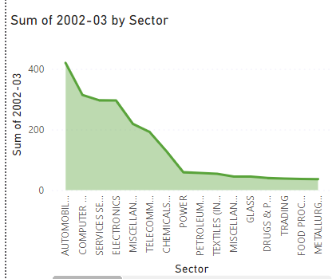
Yearly Sector Analysis - 2002-03
Automobile sector shows a strong performance.
Decline in the Miscellaneous sector’s performance.

Slide 7
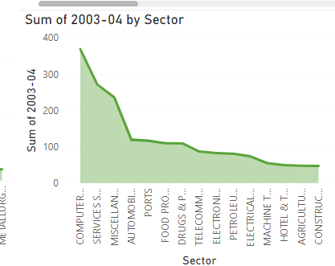
Yearly Sector Analysis - 2003-04
Computer sector takes the lead.
Steady performance in Services and Miscellaneous sectors.

Slide 8
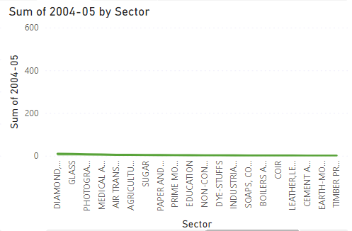
Yearly Sector Analysis - 2004-05
Diverse sectors like Air Transport and Agriculture show up.
Consistent top performers remain visible.

Slide 9
Summary:
The sector analysis shows shifts in leading sectors over the years.
Consistent performers provide stability.
Future Outlook:
Potential growth in Emerging Sectors.
Continuing trends in top-performing sectors could indicate future investment opportunities.

Slide 10
Thank you !

